Slide 1

HPM Pretilachlor 37% EW

Slide 2
Technical Information of HIFIT PLUS
Trade Name : HIFIT PLUS
Technical : PRETILACHLOR 37% EW
Formulation : EW
Chloroactamide class of herbicides.
Dosage : 600 ml /acre
Available pack size : 600 ml

Slide 3
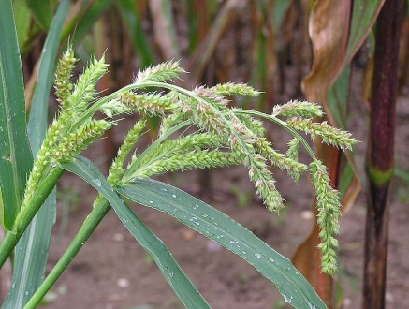

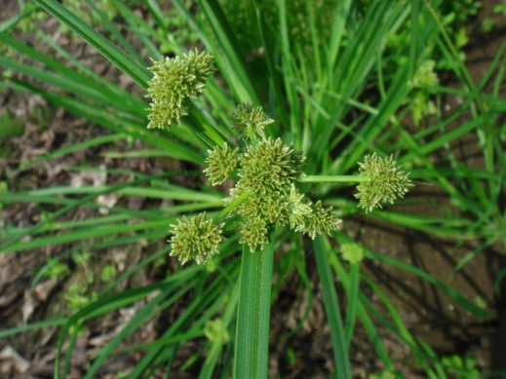
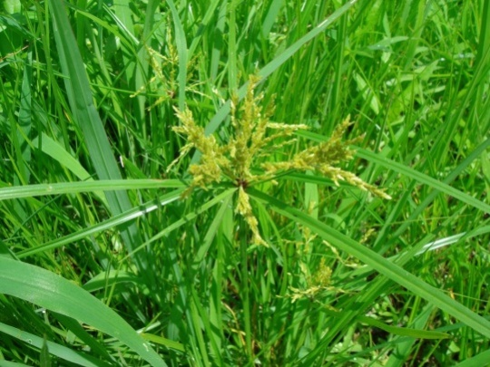
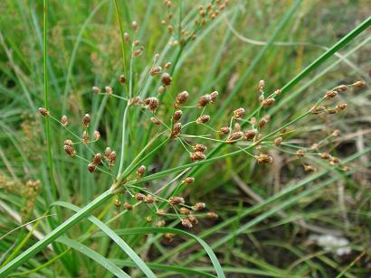
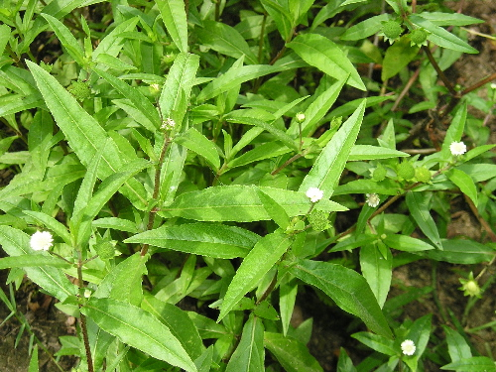
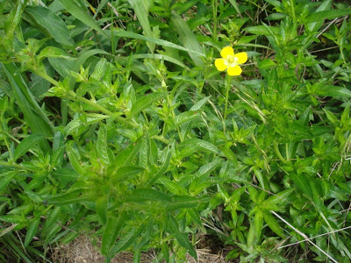

WEEDs IN PADDY…….
WEEDs IN PADDY…….
Echinochloa crusgalli
Echinochloa colonum
Cyperus difformis
Cyperus Iria
Fimbristylis miliacea
Eclipta Alba
Monochoria vaginalis
Ludwigia parviflora

Slide 4


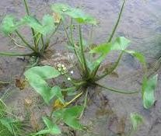

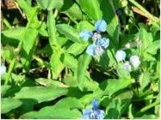
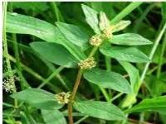
WEEDs IN PADDY…BROAD LEAF
ECLIPTA ALBA
M. VANGINALIS
Sagittaria lancifolia
LUDWIGIA Parviflora
Commelina benghalensis
Euphorbia hirta

Slide 5
HIFIT PLUS…..
1. Pre emergence.
2. Residual action for 50 days.
3. Excellent selectivity on rice.
4. No Phytotoxicity.
5. Control Seeds Borne of Weeds

Slide 6
Weeds Control…....
HIFIT PLUS
1. Excellent Selective Pre-emergent Herbicide
2. Residual action for 50 days.
4. No phytotoxicity on Plant.
5. Controls annual grasses, some Broad leaf weeds and Sedges
6. EW formulation Dose 400- 600 ml / Acre
7. Excellent Control of many grasses, sedges, and broad-leaved weeds such as Echinochloa crusgalli, Digitaria sanguinalis, and Cyperus iria

Slide 7
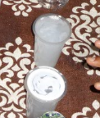
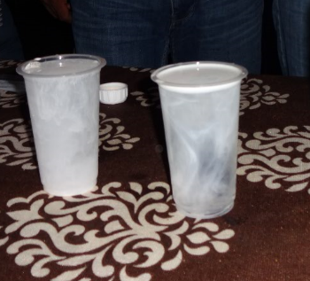

Slide 8
HIFIT PLUS….. Features & Benefits
Features | Benefits
Broad application window | Grower can apply Hifit Plus with his convenience in that window.
Excellent and worldwide proven Graminicide ( for Grasses), and provide good control of Sedges and Broad Leaves. | One shot solution, total weed control.
Safe to Nursery and Main Crop | No Phyto-toxicity and very safe to crop.
Product for all type of Rice sowing – Nursery, transplanted & Direct seeded Rice. | One product for all Rice.

Slide 9
HIFIT PLUS….. Main Customer Benefits
Reliable pre-emergence to early post-emergence activity for the early elimination of weeds competing with the crop
Highly efficient control of annual grasses, including Echinochloa spp., Leptochloa spp., Ischaemum spp., some annual sedges and broadleaf weeds
Good compatibility for mixtures with other herbicides to complement the spectrum of Hifit Plus and to extend its application window

Slide 10
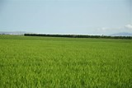
THANKS

